Slide 1

Road Accident Analysis
This Road Accident analysis offers valuable insights for data analysts, transportation professionals, and government officials by analyzing road accident data across a range of attributes, including total casualties, vehicle types, road conditions, and environmental factors. This resource enables data-driven decision-making to enhance road safety and reduce the impact of accidents.
- By Udit Bahuguna

Slide 2
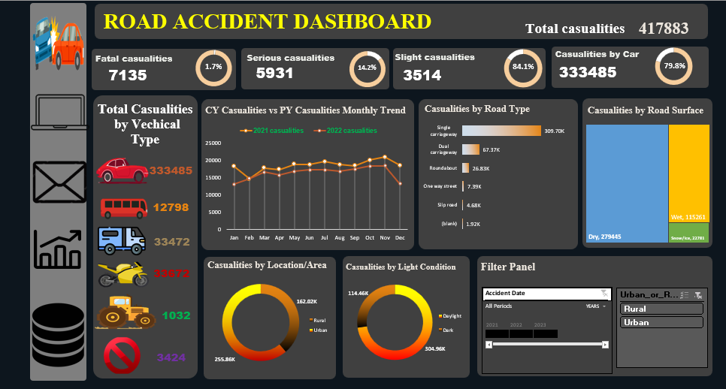
Dashboard

Slide 3


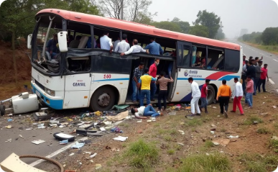
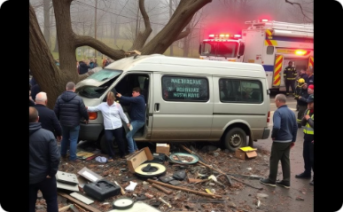
Casualties by Vehicle Type
Cars
Motorcycles
Buses/Coaches
Vans/Light Goods
Accounting for 79.8% of total casualties, cars are the most common vehicle type involved in road accidents.
Motorcycles contribute 8.8% of the total casualties, highlighting the vulnerability of this mode of transportation.
Bus and coach-related accidents account for 3.1% of total casualties, underscoring the need for enhanced safety measures in public transportation.
Vans and light goods vehicles are involved in 8% of total casualties, emphasizing the importance of promoting safe driving practices in the commercial sector.

Slide 4

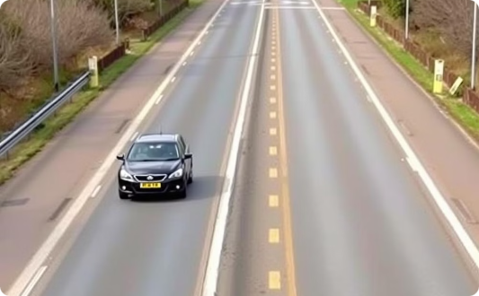

Casualties by Road Type
Single Carriageway
Dual Carriageway
Other Road Types
The majority of casualties, 74.1%, occur on single carriageway roads, indicating the need for improved infrastructure and traffic management on these routes.
Dual carriageway roads account for 16.1% of total casualties, suggesting that safety measures on these highways should also be a priority.
Roundabouts, one-way streets, and slip roads make up the remaining 9.8% of casualties, highlighting the importance of considering the unique safety challenges posed by diverse road configurations.

Slide 5



Casualties by Road Surface
Dry Roads
Wet Roads
Snow/Ice
The majority of casualties, 66.8%, occur on dry road surfaces, emphasizing the need for proactive maintenance and addressing potential hazards on these seemingly safe conditions.
Wet road surfaces account for 27.5% of total casualties, underscoring the importance of educating drivers on safe driving practices in inclement weather and ensuring proper drainage infrastructure.
Accidents on roads with snow or ice conditions contribute 5.7% of total casualties, highlighting the critical need for effective winter maintenance and driver preparedness in cold-weather regions.

Slide 6

Casualties by Location and Light Condition
Urban vs. Rural
Light Conditions
The data reveals that 61.2% of casualties occur in urban areas, while 38.8% happen in rural settings. This information can guide targeted safety interventions and resource allocation in both urban and rural transportation networks.
Interestingly, 72.9% of casualties take place in dark conditions, compared to 27.1% in daylight. This finding underscores the need for enhanced street lighting, improved visibility, and driver awareness in low-light environments.

Slide 7
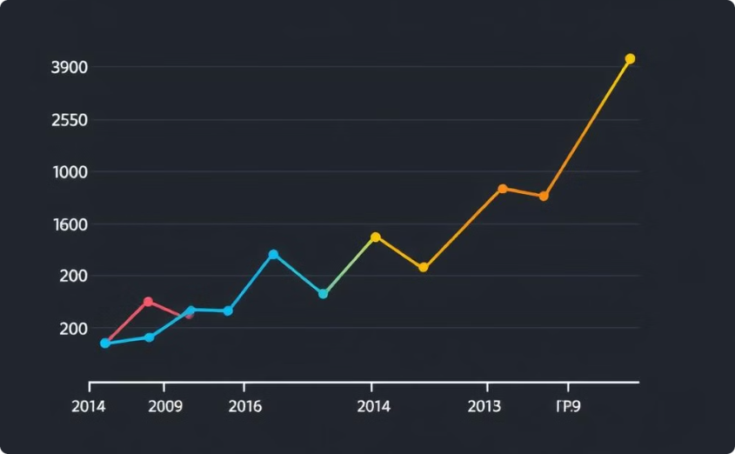
Monthly Casualty Trends
Overall Trend
Year-on-Year Comparison
The line graph depicting the monthly casualty trends for the current year (2022) shows a relatively stable pattern, with some minor fluctuations throughout the months. This data can be used to identify seasonal patterns and potential contributing factors to guide targeted interventions.
Comparing the current year's trend to the previous year (2021) allows transportation professionals to identify any significant changes or deviations in the overall road accident landscape. This comparative analysis can inform policy decisions and resource allocation to address emerging issues.

Slide 8



Filtering and Customization
Accident Date
Urban or Rural
Customizable Visualizations
The dashboard offers the ability to filter the data by different time periods, such as "All Periods," "2021," and "2022." This allows users to analyze trends and changes over time, supporting data-driven decision-making.
The dashboard provides a selector to filter the data by urban or rural areas. This feature enables transportation professionals to focus on specific geographic areas and tailor their safety strategies accordingly.
The interactive nature of the dashboard allows users to customize the visualizations, enabling a deeper and more nuanced understanding of the road accident data. This flexibility empowers data analysts and policymakers to uncover insights that align with their specific needs and objectives.

Slide 9
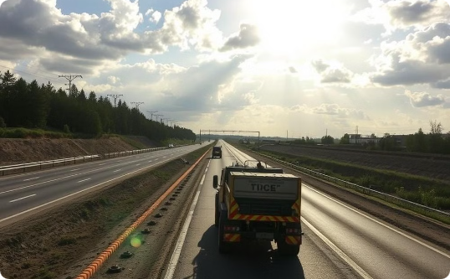


Insights and Recommendations
Infrastructure Improvements
Driver Education and Awareness
Vulnerable Road User Safety
Upgrade single carriageway roads to dual carriageways, enhance road layouts, and improve safety features on high-risk routes.
Implement targeted safety measures to protect motorcyclists, cyclists, and pedestrians, including dedicated infrastructure, visibility enhancements, and awareness campaigns.
Promote safe driving practices, educate drivers on defensive techniques, and ensure proper vehicle maintenance to mitigate risks associated with adverse weather and lighting conditions.

Slide 10
Conclusion
The "Road Accident Dashboard" provides a comprehensive and data-driven understanding of the road accident landscape, empowering transportation professionals, policymakers, and data analysts to make informed decisions and implement effective safety interventions. By analyzing the detailed attributes and visualizations, stakeholders can identify key trends, target high-risk areas, and develop targeted strategies to enhance road safety and reduce the social and economic impact of road accidents.

